Slide 1
ANGULARJS
-By Jason Dsouza

Slide 2
INDEX- 1.Overview 2.Environment 3. First AngularJS App 4.Brushing up of Javascript 5.Features of AngularJS App 6.Directives 7.Expressions 8.Controllers | 9.Filters 10.Tables 11.HTML DOM 12.Modules 13.Includes 14.AJAX 15. Views 16.Services

Slide 3
1. Overview
AngularJS is a structured Framework for Dynamic web apps.
AngularJS applications are built around a design pattern called Model-View-Controller (MVC).

Slide 4
2. Environment
How Do You Set Up Your Development Environment?
-> Choosing a Web Browser – Firefox ( debugging tool –firebug) ,Chrome ( debugging tool -Batarang)
-> Choosing a Code Editor - WebStorm and Sublime Text
-> Installing server-side - Node.js
Prerequisites –
JavaScript, basic web technologies such as HTML, CSS, AJAX etc. for learning to develop web applications using Angular JS.

Slide 5
3.Your First AngularJS App
3.1 WITHOUT ANGULARJS
<!DOCTYPE html> <html data-ng-app> <head> <title>TO DO List</title> <link href="bootstrap.css" rel="stylesheet" /> <link href="bootstrap-theme.css" rel="stylesheet" /> </head><body> <div class="page-header"> <h1>Adam's To Do List</h1> </div> | <div class="panel"> <div class="input-group"> <input class="form-control" /> <span class="input-group-btn"> <button class="btn btn-default">Add</button> </span> </div>

Slide 6
<table class="table table- striped"> <thead> <tr> <th>Description</th> <th>Done</th> </tr> </thead> <tbody> <tr> <td>Buy Flowers</td> <td>No</td> </tr> <tr> | <td>Get Shoes</td> <td>No</td> </tr> <tr> <td>Collect Tickets</td> <td>Yes</td> </tr> <tr> <td>Call Joe</td> <td>No</td> </tr> </tbody> </table> </div></body></html>

Slide 7
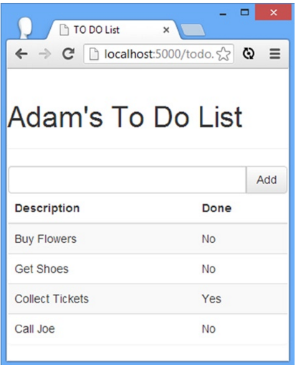
OUTPUT -

Slide 8
3.2 WITH ANGULARJS
<!DOCTYPE html> <html ng-app="todoApp"> <head> <title>TO DO List</title> <link href="bootstrap.css" rel="stylesheet" /> <link href="bootstrap-theme.css" rel="stylesheet" /> <script src="angular.js"></script> <script> var todoApp = angular.module("todoApp", []); </script> </head> <body> <div class="page-header"> <h1>Adam's To Do List</h1> </div> <div class="panel"> <div class="input-group"> <input class="form-control" /> <span class="input-group-btn"> <button class="btn btn-default"> Add</button> </span> </div> | </div> <table class="table table-striped"> <thead> <tr> <th>Description</th> <th>Done</th> </tr> </thead> <tbody> <tr><td>Buy Flowers</td> <td>No</td> </tr> <tr> <td>GetShoes</td> <td>No</td> </tr> <tr> <td>Collect Tickets</td> <td>Yes</td> </tr> <tr><td>Call Joe</td> <td>No</td> </tr> </tbody> </table> </div></body></html>

Slide 9
3.3 Creating a Data Model
The data in my to-do application is currently distributed across the HTML elements. The user’s name is contained in the header, like this:
...<h1>Adam's To Do List</h1>... and the details of the to-do items are contained within td elements in the table, like this:
...<tr><td>Buy Flowers</td><td>No</td></tr>...
My first task is to pull all of the data together and separate it from the HTML elements in order to create a model. Separating the data from the way that it is presented to the user is one of the key ideas in the MVC pattern.

Slide 10
Add the following statement into the “Without AngularJS” code –
…….. <Previous code …>
<script src="angular.js">
</script>
<script>
var model = {
user: "Adam",
items: [{ action: "Buy Flowers", done: false },
{ action: "Get Shoes", done: false },
{ action: "Collect Tickets", done: true },
{ action: "Call Joe", done: false }]
}; var todoApp = angular.module("todoApp", []);
</script>
</head><body>
………..<Remaining code>

Slide 11
3.4 Creating a Controller
……. <Previous code> <script src="angular.js"></script> <script> var model = { user: "Adam", items: [{ action: "Buy Flowers", done: false }, { action: "Get Shoes", done: false }, { action: "Collect Tickets", done: true }, { action: "Call Joe", done: false }] }; todoApp = angular.module("todoApp", []); todoApp.controller("ToDoCtrl", function ($scope) { $scope.todo = model; }); </script> </head> | <body ng-controller="ToDoCtrl"> <div class="page-header"> <h1>To Do List</h1> </div> <div class="panel"> <div class="input-group"> <input class="form-control" /> <span class="input-group-btn"> <button class="btn btn-default">Add</button> </span> </div> <table class="table table-striped"> <thead> <tr> <th>Description</th> <th>Done</th> </tr> </thead> <tbody></tbody> </table> </div></body></html>

Slide 12
3.5 Creating a View
...<body ng-controller="ToDoCtrl">
<div class="page-header">
<h1> {{todo.user}}'s To Do List
<span class="label label-default">{{todo.items.length}}</span>
</h1>
</div>
<div class="panel">
………
<tbody>
<tr ng-repeat="item in todo.items">
<td>{{item.action}}</td>
<td>{{item.done}}</td>
</tr> </tbody>
…………

Slide 13
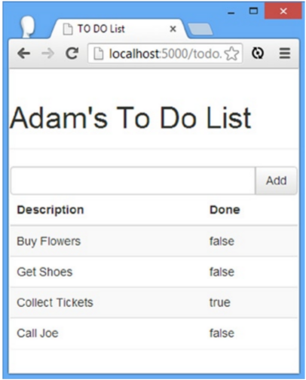
OUTPUT -

Slide 14
Inserting Model Values
Implemented using {{ and }}
...{{todo.user}}'s To Do List... is processed and transformed into the following string:
Adam's To Do List This is known as data binding or model binding.

Slide 15
Going Beyond the Basics
Using Two-Way Model Binding (ie. See how changes in the model causes changes in the view and vice-versa)
...
<tr ng-repeat="item in todo.items">
<td>{{item.action}}</td>
<td><input type="checkbox" ng-model="item.done" /></td>
<td>{{item.done}}</td>
</tr>...

Slide 16
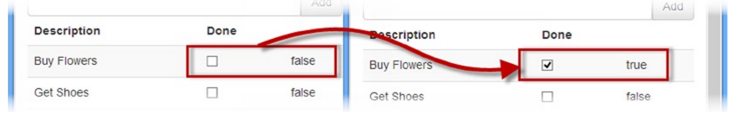

Slide 17
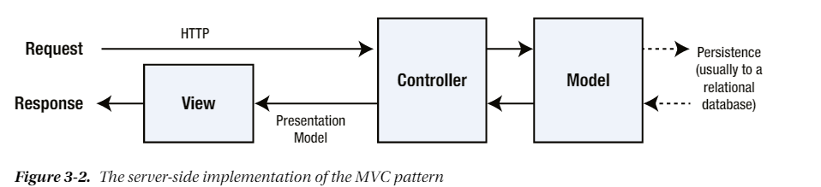
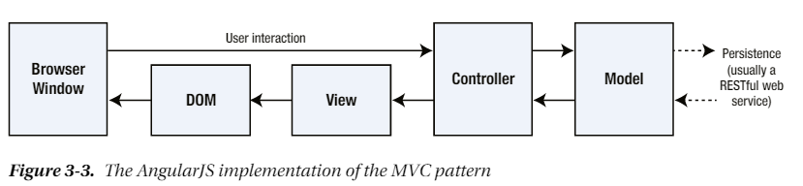
Understanding MVC -
MVC Pattern
MVC Pattern in AngularJS

Slide 18
Understanding Models
The model in an application built using the MVC pattern should :-
Contain the domain data
Contain the logic for creating, managing, and modifying the domain data (even if that means executing remote logic via web services)
Provide a clean API that exposes the model data and operations on it
The model should not :-
Expose details of how the model data is obtained or managed (in other words, details of the data storage mechanism or the remote web service should not be exposed to controllers and views)
Contain logic that transforms the model based on user interaction (because this is the controller’s job)
Contain logic for displaying data to the user (this is the view’s job)

Slide 19
Understanding Controllers
A controller built using the MVC should :-
Contain the logic required to initialize the scope
Contain the logic/behaviors required by the view to present data from the scope
Contain the logic/behaviors required to update the scope based on user interaction
The controller should not:-
Contain logic that manipulates the DOM (that is the job of the view)
Contain logic that manages the persistence of data (that is the job of the model)
Manipulate data outside of the scope

Slide 20
Understanding Views
Views should:-
Contain the logic and markup required to present data to the user
Views should not:-
Contain complex logic (this is better placed in a controller)
Contain logic that creates, stores, or manipulates the domain model

Slide 21
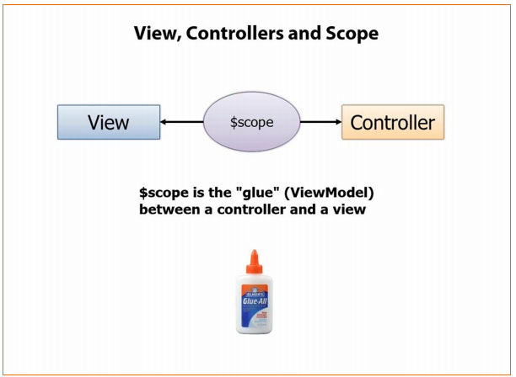

Slide 22
4. Brushing up Javascript skills
1)Add Javascript to HTML document –
Two ways to do this
...<script src="angular.js"></script>... //import
OR
...<script type="text/javascript"> ….//inline
console.log("Hello");
</script>...
2) Using Statements
..
<script src="angular.js"></script>
<script type="text/javascript">
console.log("This is a statement");
console.log("This is also a statement");
</script> …..
Output - This is a statement
This is also a statement

Slide 23
3) Defining Functions with Parameters
……
<script src="angular.js"></script>
<script type="text/javascript">
function myFunc(name, weather) {
console.log("Hello " + name + ".");
console.log("It is " + weather + " today");
};
myFunc("Adam", "sunny");
</script>

Slide 24
4) Using Variables and Types
<script src="angular.js"></script>
<script type="text/javascript">
var myGlobalVar = "apples"; function myFunc(name) {
var myLocalVar = "sunny";
return ("Hello " + name + ". Today is " + myLocalVar + "."); };
console.log(myFunc("Adam"));
</script>
<script type="text/javascript">
console.log("I like " + myGlobalVar);
</script> </head>

Slide 25
5) Creating Objects-
Way 1- var myData = new Object();
myData.name = "Adam";
myData.weather = "sunny“;
Way 2-
var myData = {
name: "Adam",
weather: "sunny"
};
6) Using Functions as Methods-
A function defined on an object is called a method.

Slide 26
<head>
<title>Example</title>
<script src="angular.js"></script>
<script type="text/javascript">
var myData = {
name: "Adam",
weather: "sunny",
printMessages: function() {
console.log("Hello " + this.name + ". ");
console.log("Today is " + this.weather + ".");
}
};
myData.printMessages();
</script></head>
Output- Hello Adam.
Today is sunny.

Slide 27
7) Extending Objects
<script type="text/javascript">
var myData = {
name: "Adam",
weather: "sunny",
printMessages: function () {
console.log("Hello " + this.name + ". ");
console.log("Today is " + this.weather + "."); }
};
var myExtendedObject = { city: "London" };
angular.extend(myExtendedObject, myData);
console.log(myExtendedObject.name);
console.log(myExtendedObject.city);
</script></head>
Output- Adam
London

Slide 28
8) Reading and Modifying the Property Values-
<script type="text/javascript">
var myData = {
name: "Adam",
weather: "sunny", };
myData.name = "Joe"; //way1
myData["weather"] = "raining"; //way2
console.log("Hello " + myData.name + ".");
console.log("It is " + myData["weather"]);
</script>
9) Enumerating an Object’s Properties-
<script type="text/javascript">
var myData = {
name: "Adam",
weather: "sunny",

Slide 29
printMessages: function () {
console.log("Hello " + this.name + ". ");
console.log("Today is " + this.weather + ".");
}
};
for (var prop in myData) {
console.log("Name: " + prop + " Value: " + myData[prop]); }
console.log("---");
angular.forEach(myData, function (value, key) {
console.log("Name: " + key + " Value: " + value);
});
Output- Name: name Value: Adam Name: weather Value: sunny Name: printMessages Value: function () { console.log("Hello " + this.name + ". "); console.log("Today is " + this.weather + ".");} --- Name: name Value: Adam Name: weather Value: sunny Name: printMessages Value: function () { console.log("Hello " + this.name + ". "); console.log("Today is " + this.weather + ".");}

Slide 30
10) Adding and Deleting Properties and Methods-
Adding-
var myData = {
name: "Adam",
weather: "sunny",
}; myData.dayOfWeek = "Monday"; </script>
Deleting- delete myData.name;
delete myData["weather"];

Slide 31
11) Determining Whether an Object Has a Property
<script type="text/javascript">
var myData = { name: "Adam", weather: "sunny", };
var hasName = "name" in myData;
var hasDate = "date" in myData;
console.log("HasName: " + hasName);
console.log("HasDate: " + hasDate);
</script>
Output- HasName: true
HasDate: false

Slide 32
5. Features of AngularJS App
AngularJS is a efficient framework that can create Rich Internet Applications (RIA).
AngularJS provides developers an options to write client side applications using JavaScript in a clean Model View Controller (MVC) way.
Applications written in AngularJS are cross-browser compliant. AngularJS automatically handles JavaScript code suitable for each browser.
AngularJS is open source, completely free, and used by thousands of developers around the world. It is licensed under the Apache license version 2.0.
Overall, AngularJS is a framework to build large scale, high performance, and easy to-maintain web applications.

Slide 33
5.1 Core Features
The most important core features of AngularJS are:
Data-binding: It is the automatic synchronization of data between model and view components.
Scope: These are objects that refer to the model. They act as a glue between controller and view.
Controller: These are JavaScript functions bound to a particular scope.
Services: AngularJS comes with several built-in services such as $http to make a XMLHttpRequests. These are singleton objects which are instantiated only once in app.
Filters: These select a subset of items from an array and returns a new array.
Directives: Directives are markers on DOM elements such as elements, attributes, css, and more. These can be used to create custom HTML tags that serve as new, custom widgets. AngularJS has built-in directives such as ngBind, ngModel etc.

Slide 34
Routing: It is concept of switching views.
Model View Whatever: MVW is a design pattern for dividing an application into different parts called Model, View, and Controller, each with distinct responsibilities. AngularJS does not implement MVC in the traditional sense, but rather something closer to MVVM (Model-View-ViewModel). The Angular JS team refers it humorously as Model View Whatever.
Deep Linking: Deep linking allows you to encode the state of application in the URL so that it can be bookmarked. The application can then be restored from the URL to the same state.
Dependency Injection: AngularJS has a built-in dependency injection subsystem that helps the developer to create, understand, and test the applications easily.

Slide 35
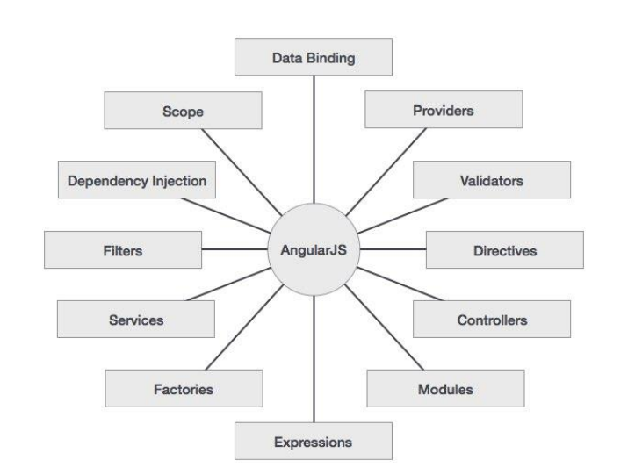

Slide 36
5.2 ADVANTAGES OF ANGULARJS
Create Single Page Application in a very clean and maintainable way.
Data binding capability to HTML ,giving users a rich and responsive experience.
Unit testable.
Uses dependency injection and make use of separation of concerns.
Reusable components.
Achieves more functionality with short code.
In AngularJS, views are pure html pages, and controllers written in JavaScript do the business processing.

Slide 37
5.3 Disadvantages of AngularJS
Not Secure : Being JavaScript only framework, application written in AngularJS are not safe. Server side authentication and authorization is must to keep an application secure.
Not degradable: If the user of your application disables JavaScript, then nothing would be visible, except the basic page.

Slide 38
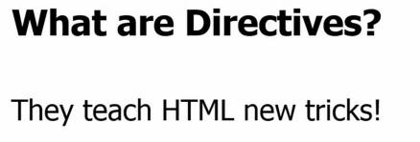
6. AngularJS Directives
ng-app : This directive defines and links an AngularJS application to HTML.
ng-model : This directive binds the values of AngularJS application data to HTML input controls.
ng-bind : This directive binds the AngularJS application data to HTML tags.

Slide 39
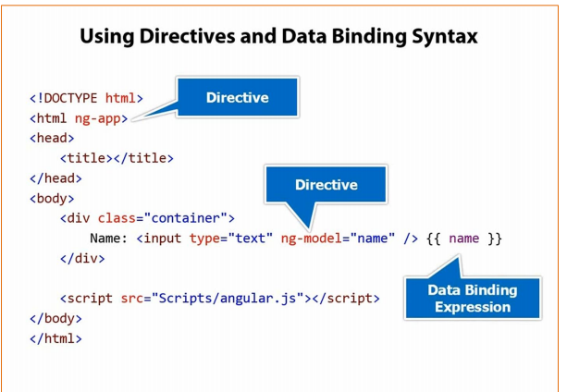

Slide 40

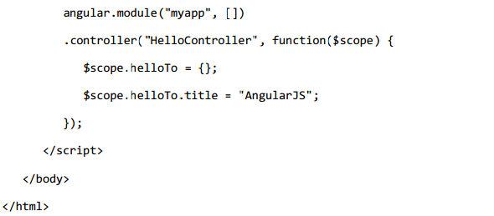
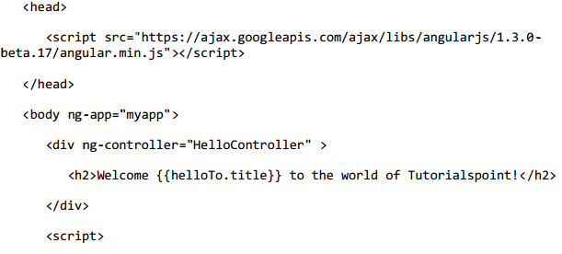
6.3 Example 2 –Step –by -Step
Step 4 -Controller
Step1 -Include AngularJS
Step 2- Point to AngularJS app
Step 3 -View
OUTPUT:-

Slide 41
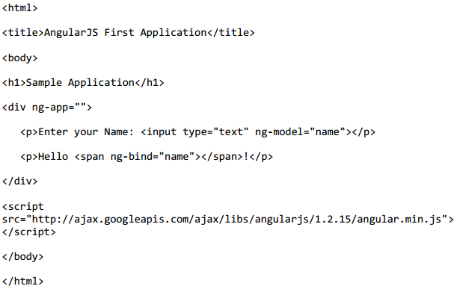
6.4 Example 3 – Application with Directives

Slide 42
6.5 Difference Between ng-bind vs ng-model
Ng-bind one-way data binding ($scope --> view). It has a shortcut {{ val }} which displays the scope value $scope.val inserted into html where val is a variable name. | Ng-model two-way data binding ($scope --> view and view --> $scope) e.g. <input ng-model="val"/>. ng-model is intended to be put inside of form elements

Slide 43
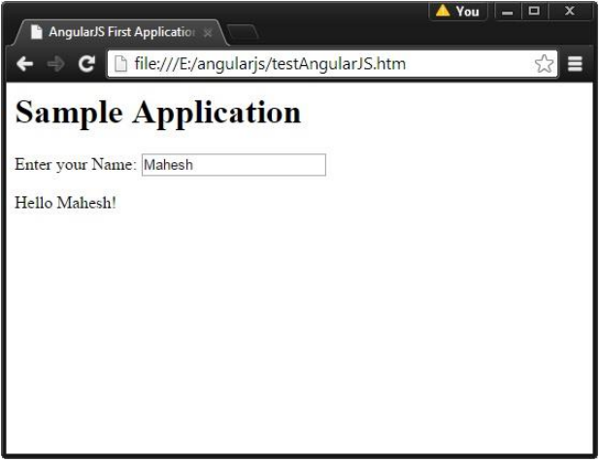
Output

Slide 44

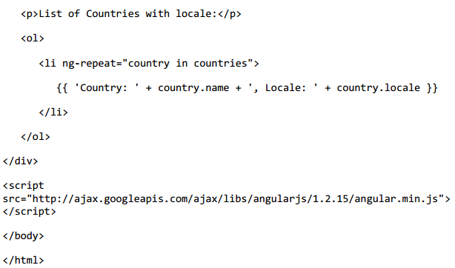
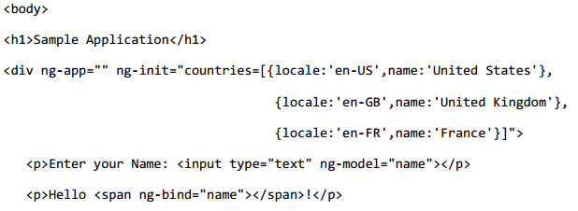
6.6 More Directives
ng-init - This directive initializes application data.
ng-repeat - This directive repeats HTML elements for each item in a collection.

Slide 45
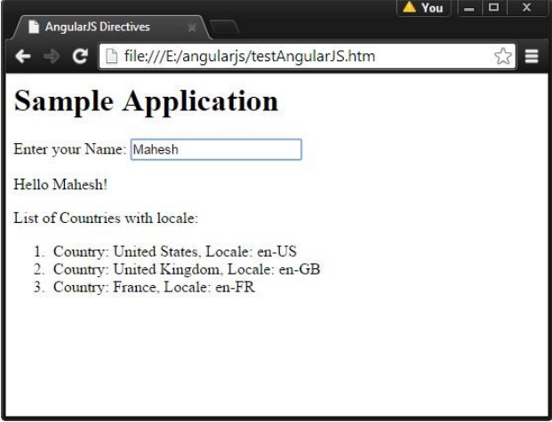

Slide 46
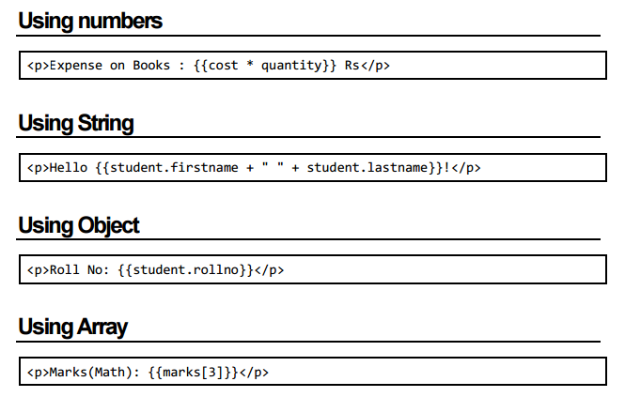
7. EXPRESSIONS
Bind application data to HTML.
Written inside double curly braces such as in {{ expression}}

Slide 47
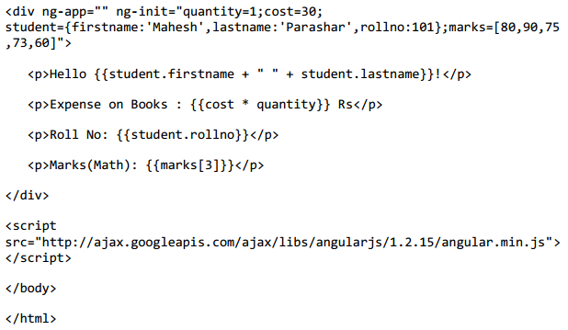
Example

Slide 48
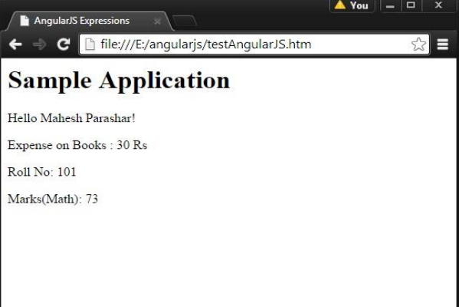
OUTPUT

Slide 49

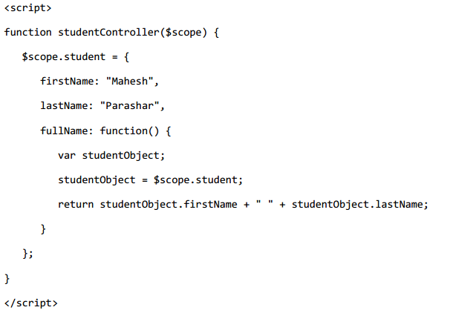
8. CONTROLLERS

Slide 50
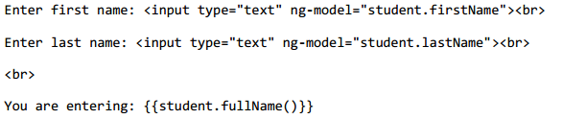
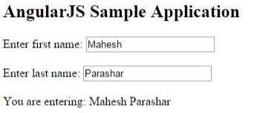
In the view :
OUTPUT:-

Slide 51
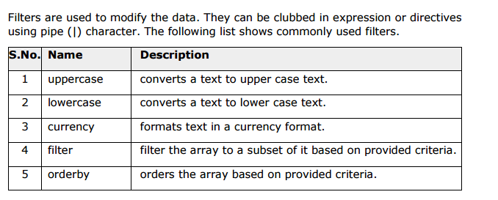
9.FILTERS

Slide 52


LOWERCASE FILTER
UPPERCASE FILTER

Slide 53

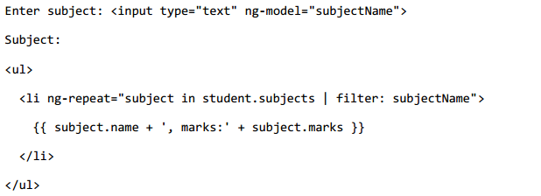
CURRENCY FILTER
FILTER FILTER

Slide 54
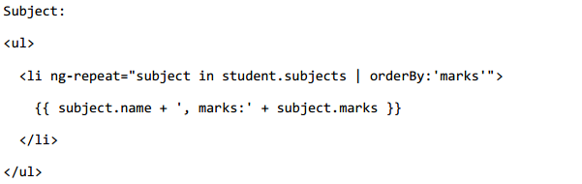
ORDERBY FILTER

Slide 55
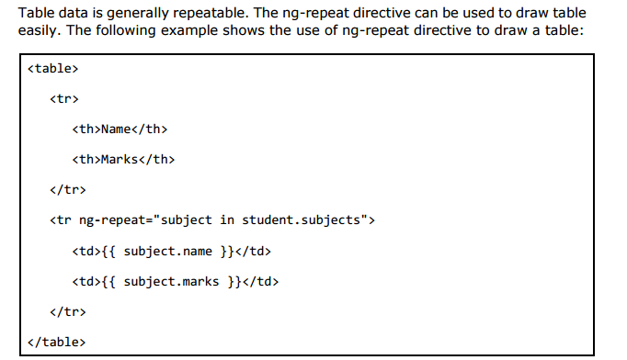
10. TABLES

Slide 56
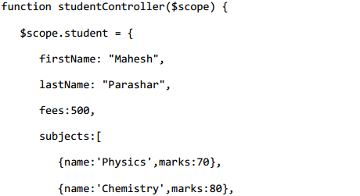
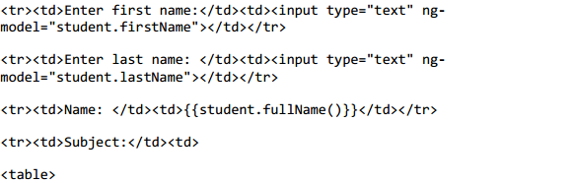
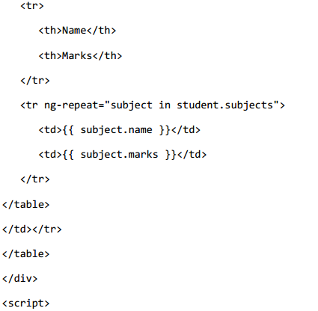
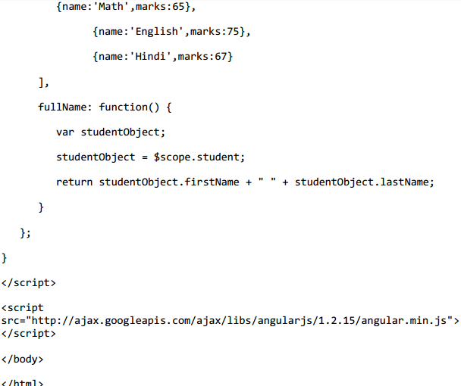

Slide 57
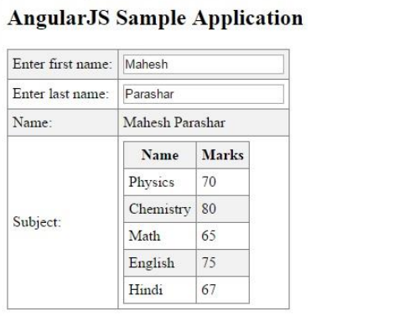
OUTPUT

Slide 58
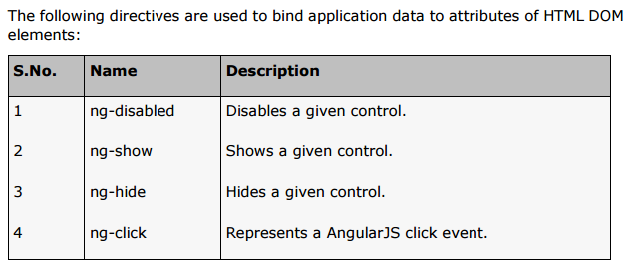
11. HTML DOM

Slide 59
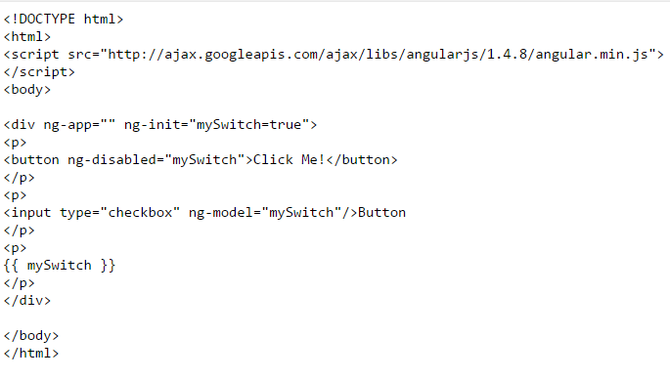
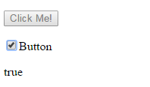
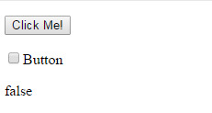
INITIAL:-
AFTER UNCHECKING CHECKBOX:-

Slide 60
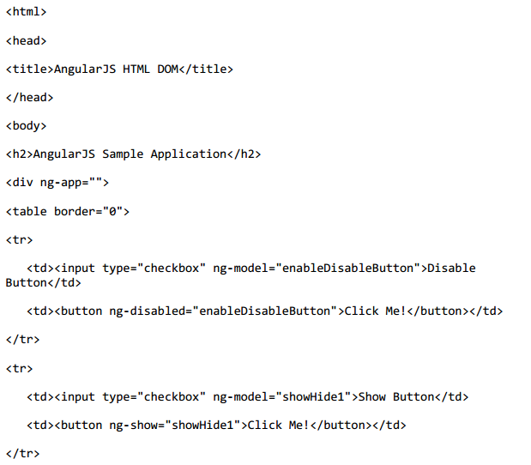
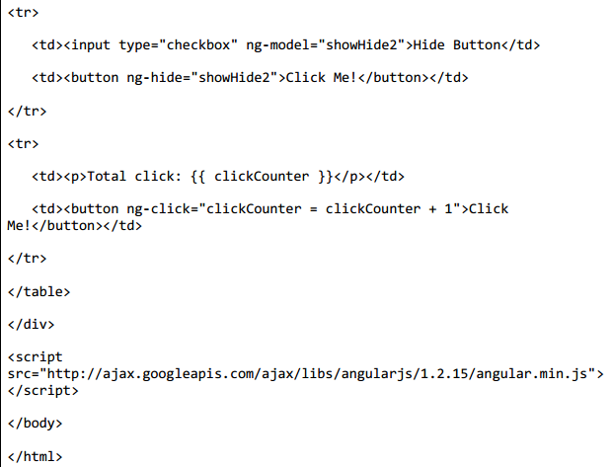
EXAMPLE 2-

Slide 61
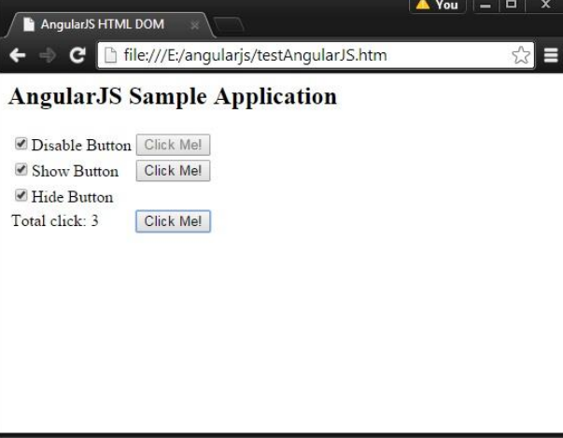
OUTPUT -

Slide 62
12. MODULES
AngularJS supports modular approach.
Modules are used to separate logic such as services, controllers, application etc. from the code and maintain the code clean.
In the following example, we are going to create two modules:
Application Module - used to initialize an application with controller(s).
Controller Module - used to define the controller.

Slide 63
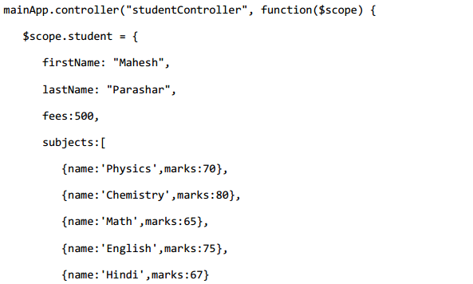
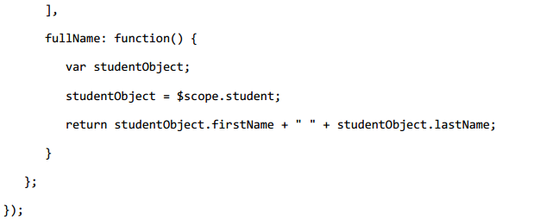
APPLICATION MODULE -mainApp.js
CONTROLLER MODULE -studentController.js

Slide 64
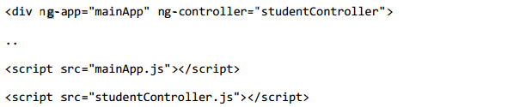
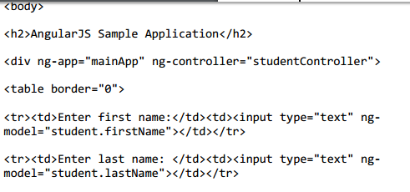
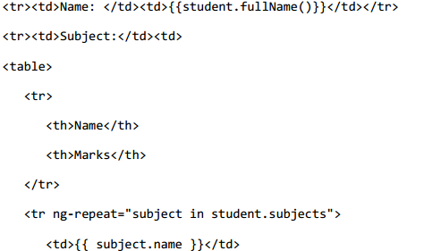
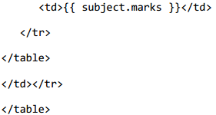
Use Modules
Here, we use application module using ng-app directive, and controller using ngcontroller directive. We import the mainApp.js and studentController.js in the main HTML page.

Slide 65
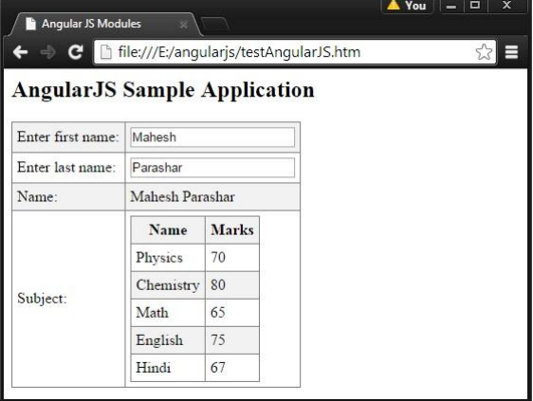
OUTPUT

Slide 66
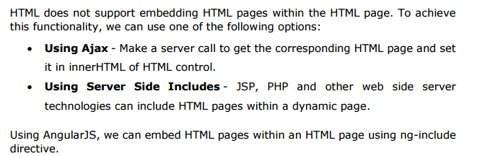
14. INCLUDES

Slide 67
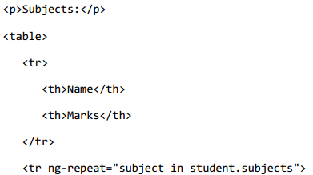
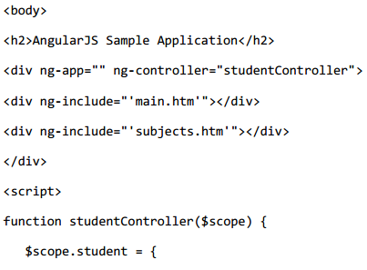
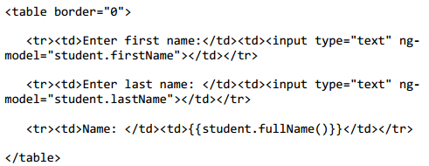

tryAngularJS.htm | main.htm | subjects.htm
……..

Slide 68
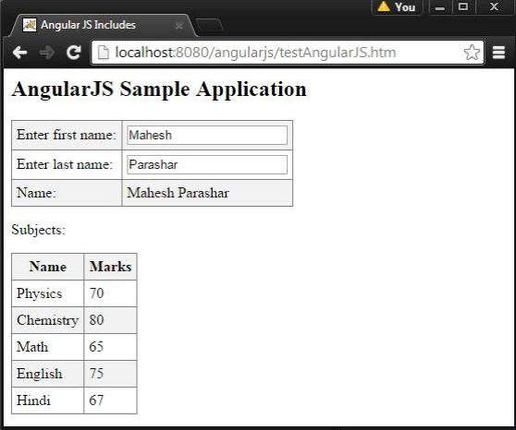
OUTPUT

Slide 69

15.AJAX

Slide 70




Data.txt
View | Controller

Slide 71

OUTPUT

Slide 72


16. VIEWS
AngularJS supports Single Page Application via multiple views on a single page.
To do this, AngularJS has provided ng-view and ng-template directives, and
$routeProvider services.

Slide 73



Slide 74


$routeProvider Service:-
$routeProvider is a key service which sets the configuration of URLs, maps them with the corresponding HTML page or ng-template, and attaches a controller with the same.

Slide 75


EXAMPLE WITH ROUTEPROVIDER
STEP1- include AngularJS Route module
Links To routes
Ng-view Directive

Slide 76




Inject ngRoute Dependancy
Configuring $RouteProvider

Slide 77

OUTPUT

Slide 78
Example2 (view)- Index.html <div ng-controller="MainCtrl" ng-app=app> <h1>{{page.title()}}</h1> <p> <a href="#/home">Home</a> | <a href="#/list">List</a> | <a href="#/settings">Settings</a> </p> <hr> <ng-view>Loading...</ng-view> <hr> Footer <!-- Inline Templates (Partials) --> <script type=text/ng-template id=home.html> <!-- Home --> <ul> <li><a href="#/list">Show Items</a></li> <li><a href="#/settings">Settings</a></li> </ul> </script> <script type=text/ng-template id=list.html> <!-- List --> <p>Choose an Item</p> <ul> <li ng-repeat="item in items"><a href="#/detail/{{item.id}}">{{item.title}}</a></li> </ul> </script> | <script type=text/ng-template id=detail.html> <!-- Detail --> <h2>{{item.title}}</h2> <p>{{item.detail}}</p> <hr> <p>{{item.id}}</p> </script> <script type=text/ng-template id=settings.html> <!-- Settings --> <p>Settings go here ...</p> </script> </div>

Slide 79
angular.module('app', ['appServices']) .config(['$routeProvider', function($routeProvider) { $routeProvider. when('/home', {templateUrl: 'home.html', controller: HomeCtrl}). when('/list', {templateUrl: 'list.html', controller: ListCtrl}). when('/detail/:itemId', {templateUrl: 'detail.html', controller: DetailCtrl}). when('/settings', {templateUrl: 'settings.html', controller: SettingsCtrl}). otherwise({redirectTo: '/home'}); }]); /* Controllers */ function MainCtrl($scope, Page) { console.log(Page); $scope.page= Page; } function HomeCtrl($scope, Page) { Page.setTitle("Welcome"); } function ListCtrl($scope, Page, Model) { Page.setTitle("Items"); $scope.items = Model.notes(); } | function DetailCtrl($scope, Page, Model, $routeParams, $location) { Page.setTitle("Detail"); var id = $scope.itemId = $routeParams.itemId; $scope.item = Model.get(id); } function SettingsCtrl($scope, Page) { Page.setTitle("Settings"); } /* Services */ angular.module('appServices', []) .factory('Page', function($rootScope){ var pageTitle = "Untitled"; return { title:function(){ return pageTitle; }, setTitle:function(newTitle){ pageTitle = newTitle; } } }) | .factory ('Model', function () { var data = [ {id:0, title:'Doh', detail:"A dear. A female dear."}, {id:1, title:'Re', detail:"A drop of golden sun."}, {id:2, title:'Me', detail:"A name I call myself."}, {id:3, title:'Fa', detail:"A long, long way to run."}, {id:4, title:'So', detail:"A needle pulling thread."}, {id:5, title:'La', detail:"A note to follow So."}, {id:6, title:'Tee', detail:"A drink with jam and bread."} ]; return { notes:function () { return data; }, get:function(id){ return data[id]; }, add:function (note) { var currentIndex = data.length; data.push({ id:currentIndex, title:note.title, detail:note.detail }); }, delete:function (id) { var oldNotes = data; data = []; angular.forEach(oldNotes, function (note) { if (note.id !== id) data.push(note); }); } } });

Slide 80



On clicking Home- | On clicking List- | On clicking Settings-

Slide 81
17. SERVICES
Services are JavaScript functions, which are responsible to perform only specific tasks.
This makes them individual entities which are maintainable and testable.
The controllers and filters can call them on requirement basis.
Services are normally injected using dependency injection mechanism of AngularJS.
There are two ways to create a service:
• Factory
• Service
Angular services are:
Lazily instantiated – Angular only instantiates a service when an application component depends on it.
Singletons – Each component dependent on a service gets a reference to the single instance generated by the service factory.

Slide 82
WHY NEED SERVICE ??
It’s important to realize early on that your controller should be very thin.
If you’re trying to have persistent data in his or her controller, then That’s just not the purpose of a controller.
For memory purposes, controllers are instantiated only when they are needed and discarded when they are not.
Because of this, every time you switch a route or reload a page, Angular cleans up the current controller.
Services however provide a means for keeping data around for the lifetime of an application while they also can be used across different controllers in a consistent manner.

Slide 83


Factory:- When you’re using a Factory you create an object, add properties to it, then return that same object. When you pass this service into your controller, those properties on the object will now be available in that controller through your factory. A factory is not. | Service:- 2) When you’re using Service, it’s instantiated with the ‘new’ keyword. Because of that, you’ll add properties to ‘this’ and the service will return ‘this’. When you pass the service into your controller, those properties on ‘this’ will now be available on that controller through your service. A service is a constructor function .

Slide 84




Slide 85






Slide 86

OUTPUT

Slide 87
Example2 (service/Factory)- Index.html <div ng-controller="HelloCtrl"> <p>{{fromService}}</p> <p>{{fromFactory}}</p> </div> <br /> <div ng-controller="GoodbyeCtrl"> <p>{{fromService}}</p> <p>{{fromFactory}}</p> </div> | Factoryangular.js var app = angular.module('myApp', []); app.factory('testFactory', function(){ return { sayHello: function(text){ return "Factory says \"Hello " + text + "\""; }, sayGoodbye: function(text){ return "Factory says \"Goodbye " + text + "\""; } } }); app.service('testService', function(){ this.sayHello= function(text){ return "Service says \"Hello " + text + "\""; }; this.sayGoodbye = function(text){ return "Service says \"Goodbye " + text + "\""; }; }); | function HelloCtrl($scope, testService, testFactory) { $scope.fromService = testService.sayHello("World"); $scope.fromFactory = testFactory.sayHello("World"); } function GoodbyeCtrl($scope, testService, testFactory) { $scope.fromService = testService.sayGoodbye("World"); $scope.fromFactory = testFactory.sayGoodbye("World"); }

Slide 88

OUTPUT

Slide 89
References-
[1] Tutorialspoint , http://www.tutorialspoint.com/angularjs/angularjs_tutorial.pdf
[2] ProAngular
[3]Official Documentation of Angular

Slide 90
THANK YOU.

